Slide 1
WELCOME
Weekly Report
Vatsla Adhikari
Dec. 1, 2023

Slide 2
INDEX
Slide 1: Weekly Report
Slide 2: Index
Slide 3: DB Connectivity
Slide 4: Accessing the database through four functions.
Slide 5-12: The code layout.
Slide 13: Demonstration for the graph plottings.
Slide 14: Tested histogram output.

Slide 3
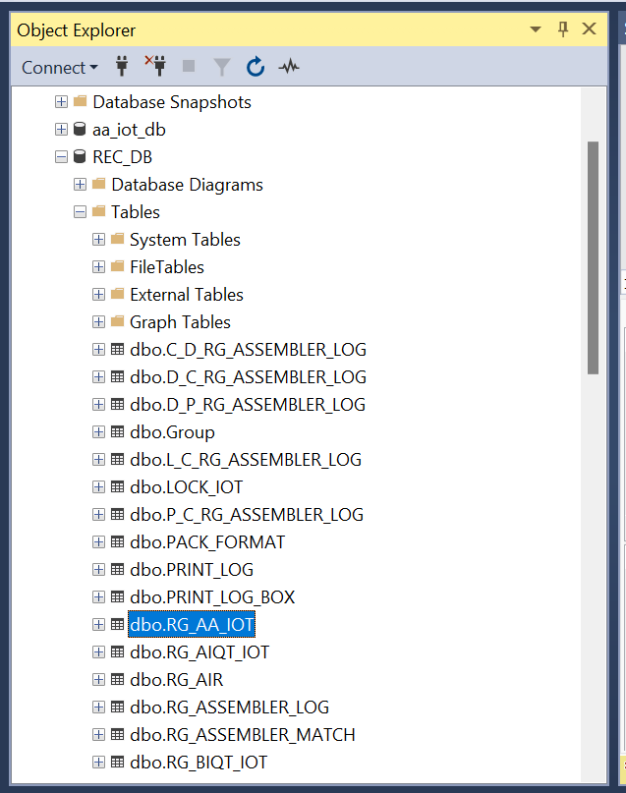
Objective: Database Connectivity.
import pyodbc
import pandas as pd
def connect(server_name, database_name, username, password):
connection_string = f'DRIVER={{SQL Server}};SERVER={server_name};DATABASE={database_name};UID={username};PWD={password}'
try:
connection = pyodbc.connect(connection_string)
print("Connected to the database.")
return connection
except Exception as e:
print(f"Error: Unable to connect to the database\n{e}")
return None
def main():
server_name = 'REC-Wip'
database_name = 'REC_DB'
username = 'sa'
password = 'Rg54013657'
connection = connect(server_name, database_name, username, password)

Slide 4
Objective: Accessing the database through four functions:
=> MTF_oneLot
=> CxCy_oneLot
=> MTF_LatestNLots
=> CxCy_LatestNLots
MTF_oneLot:
This function connects to a database, retrieves data for a specific travel card, and then plots histograms for each unique test item. The histograms display the average values of different test points. The function is designed for a single travel card (specific_travel_card_number) and a specific station (station_name).
CxCy_oneLot:
Similar to MTF_oneLot, this function connects to a database, retrieves data for a specific travel card, and plots histograms. However, it focuses on a different set of test points (TEST_CE0 and TEST_CE1) and is intended for a different station (station_name).
MTF_LatestNLots:
This function retrieves data for the top N travel cards from a specific station, orders them by test datetime, and plots histograms for each unique test item. The histograms display the average values of different test points, similar to MTF_oneLot.
CxCy_LatestNLots:
Similar to MTF_LatestNLots, this function retrieves data for the top N travel cards from a specific station, orders them by test datetime, and plots histograms. However, it focuses on a different set of test points (TEST_CE0 and TEST_CE1), and is intended for a different station (station_name).

Slide 5
Objective: The code layout.
(Need to be tested once for the histograms on Monday)
MTF_oneLot:
Summary:
def find_MTF_oneLot(connection, station_name, travel_card_number):
sql_query = f"""
SELECT [TEST_ITEM], [TEST_CE0], [TEST_CE1], [TEST_UL0], [TEST_UL1], [TEST_UR0], [TEST_UR1],
[TEST_BL0], [TEST_BL1], [TEST_BR0], [TEST_BR1]
FROM [REC_DB].[dbo].[{station_name}]
WHERE [TRAVEL_CARD_NUMBER] = '{travel_card_number}'
ORDER BY [TEST_DATETIME] DESC
"""
data_result = execute_query(connection, sql_query)
# Ensure numeric conversion
data_result = data_result.copy()
numeric_columns = [
'TEST_CE0', 'TEST_CE1',
'TEST_UL0', 'TEST_UL1',
'TEST_UR0', 'TEST_UR1',
'TEST_BL0', 'TEST_BL1',
'TEST_BR0', 'TEST_BR1'
]
data_result[numeric_columns] = data_result[numeric_columns].apply(pd.to_numeric, errors='coerce')
print(f"\nData for Travel Card '{travel_card_number}':")
print(data_result)
for test_item in data_result['TEST_ITEM'].unique():
filtered_data = data_result[data_result['TEST_ITEM'] == test_item]
plot_histogram(filtered_data, f"Histogram for Travel Card '{travel_card_number}'", test_item, station_name)
return data_result
The `find_MTF_oneLot` function is designed to fetch and analyze test data from a specified station and for a particular travel card number. It constructs a SQL query to select relevant columns, such as test item names and corresponding measurements, from the designated station's database table. The query filters results based on the provided travel card number and orders them by the test date in descending order. Upon executing the query through the `execute_query` function, the retrieved data is then subjected to numeric conversion for specific columns. The function prints the resulting data table, and for each unique test item, it generates and displays a histogram using the `plot_histogram` function. The histograms visualize the distribution of average values associated with different test points. The function ultimately returns the data result, providing insights into the performance of the specified travel card at the given station.

Slide 6
MTF_oneLot:
Summary:
def plot_histogram(data_result, title, test_item, station_name):
if data_result is not None and not data_result.empty:
numeric_columns = [
'TEST_CE0', 'TEST_CE1',
'TEST_UL0', 'TEST_UL1',
'TEST_UR0', 'TEST_UR1',
'TEST_BL0', 'TEST_BL1',
'TEST_BR0', 'TEST_BR1'
]
data_result[numeric_columns] = data_result[numeric_columns].apply(pd.to_numeric, errors='coerce')
if station_name == 'RG_AA_IOT':
x_values = []
y_values = []
avg_points_list = [] # List to store average points for each row
for idx, row in enumerate(data_result.itertuples()):
if test_item == 'FOCUS_ANALYTICS':
avg_point1 = (getattr(row, 'TEST_CE0') + getattr(row, 'TEST_CE1')) / 2
avg_point2 = (getattr(row, 'TEST_UL0') + getattr(row, 'TEST_UL1')) / 2
avg_point3 = (getattr(row, 'TEST_UR0') + getattr(row, 'TEST_UR1')) / 2
avg_point4 = (getattr(row, 'TEST_BL0') + getattr(row, 'TEST_BL1')) / 2
avg_point5 = (getattr(row, 'TEST_BR0') + getattr(row, 'TEST_BR1')) / 2
x_values.extend([avg_point1, avg_point2, avg_point3, avg_point4, avg_point5])
y_values.extend([idx + 1] * 5)
avg_points_list.append((avg_point1, avg_point2, avg_point3, avg_point4, avg_point5))
colors = ['red', 'blue', 'green', 'yellow', 'orange'][:len(x_values)]
plt.bar(x_values, y_values, color=colors, alpha=0.5)
plt.xlabel('Average Value')
plt.ylabel('Rows')
plt.title(f"{title} - {test_item} ({station_name})")
plt.show()
# Print a table with average point values
print("\nAverage Points Table:")
columns = [f'Point {i}' for i in range(1, 6)]
avg_points_df = pd.DataFrame(avg_points_list, columns=columns)
print(avg_points_df)
The `plot_histogram` function generates and displays histograms for a given set of test data, providing visual insights into the distribution of average values associated with specific test points. It first checks if the input data, `data_result`, is not empty and is a valid DataFrame. The function then identifies relevant numeric columns and ensures their conversion to numeric types. Depending on the specified `station_name`, the function plots histograms differently. For the station named 'RG_AA_IOT' and when the `test_item` is 'FOCUS_ANALYTICS', it calculates and displays the average values for five specific test points across multiple rows. These values are visualized using a bar chart, and a corresponding table of average points is printed. For other stations or test items, the function utilizes all ten test points, generating histograms and tables similarly. If no data is found, a message indicating the absence of data for the specified title is printed. The function provides a flexible and informative way to visualize and analyze test data distributions for different scenarios.
else:
for idx, row in enumerate(data_result.itertuples()):
if test_item == 'FOCUS_ANALYTICS':
# Use all ten points for other stations
avg_points = [getattr(row, col) for col in numeric_columns]
x_values = avg_points
y_values = [idx + 1] * 10
avg_points_list = [tuple(avg_points)]
colors = ['red', 'blue', 'green', 'yellow', 'orange', 'pink', 'black', 'cream', 'purple', 'silver'][:len(x_values)]
plt.bar(x_values, y_values, color=colors, alpha=0.5)
plt.xlabel('Average Value')
plt.ylabel('Rows')
plt.title(f"{title} - {test_item} ({station_name})")
plt.show()
# Print a table with average point values
print("\nAverage Points Table:")
columns = [f'Point {i}' for i in range(1, 11)]
avg_points_df = pd.DataFrame(avg_points_list, columns=columns)
print(avg_points_df)
else:
print(f"No data found for {title}.")

Slide 7
Objective: The code layout.
(Need to be tested once for the histograms on Monday)
CxCy_oneLot:
Summary:
def find_CxCy_oneLot(connection, station_name, travel_card_number):
sql_query = f"""
SELECT [TEST_ITEM], [TEST_CE0], [TEST_CE1]
FROM [REC_DB].[dbo].[{station_name}]
WHERE [TRAVEL_CARD_NUMBER] = '{travel_card_number}'
ORDER BY [TEST_DATETIME] DESC
"""
data_result = execute_query(connection, sql_query)
# Ensure numeric conversion
data_result = data_result.copy()
numeric_columns = [
'TEST_CE0', 'TEST_CE1',
]
data_result[numeric_columns] = data_result[numeric_columns].apply(pd.to_numeric, errors='coerce')
print(f"\nData for Travel Card '{travel_card_number}':")
print(data_result)
for test_item in data_result['TEST_ITEM'].unique():
filtered_data = data_result[data_result['TEST_ITEM'] == test_item]
plot_histogram(filtered_data, f"Histogram for Travel Card '{travel_card_number}'", test_item, station_name)
return data_result
The `find_CxCy_oneLot` function is designed to retrieve and analyze specific test data associated with a given travel card number from a specified station's database. It constructs a SQL query to select the relevant columns, such as test item names and corresponding measurements (specifically, 'TEST_CE0' and 'TEST_CE1'). The query filters results based on the provided travel card number and orders them by the test date in descending order. After executing the query using the `execute_query` function, the resulting data is subjected to numeric conversion for specific columns. The function then prints the obtained data table, and for each unique test item, it generates and displays a histogram using the `plot_histogram` function. These histograms visually represent the distribution of average values for the specified test points, offering insights into the performance of the travel card at the designated station. The function ultimately returns the data result for further analysis and interpretation.

Slide 8
Objective: The code layout.
(Need to be tested once for the histograms on Monday)
CxCy_oneLot:
Summary:
def plot_histogram(data_result, title, test_item, station_name):
if data_result is not None and not data_result.empty:
numeric_columns = [
'TEST_CE0', 'TEST_CE1',
]
data_result[numeric_columns] = data_result[numeric_columns].apply(pd.to_numeric, errors='coerce')
x_values = []
y_values = []
colors = []
for idx, row in enumerate(data_result.itertuples()):
if test_item == 'IMAGE_CENTER':
point1 = getattr(row, 'TEST_CE0')
point2 = getattr(row, 'TEST_CE1')
x_values.extend([point1, point2])
y_values.extend([idx + 1] * 2)
colors.extend(['red', 'blue'])
plt.bar(x_values, y_values, color=colors, alpha=0.5)
plt.xlabel('Value')
plt.ylabel('Rows')
plt.title(f"{title} - {test_item}")
plt.show()
else:
print(f"No data found for {title}.")
The `plot_histogram` function is designed to generate and display histograms for a specific set of test data, offering a visual representation of the distribution of average values associated with test points. It first checks if the input data, `data_result`, is not empty and is a valid DataFrame. The function then identifies relevant numeric columns and ensures their conversion to numeric types. Depending on the specified `test_item`, in this case, 'IMAGE_CENTER', the function calculates and visualizes the values for two specific test points, 'TEST_CE0' and 'TEST_CE1', across multiple rows. These values are represented using a bar chart, with each row contributing two bars, and the bars are color-coded. If no data is found, a message indicating the absence of data for the specified title is printed. This function provides a concise and adaptable way to visualize and interpret the distribution of test data for a specific test item, aiding in the analysis of test performance.

Slide 9
Objective: The code layout.
(Need to be tested once for the histograms on Monday)
MTF_LatestNLots:
def find_MTF_latestNLots(connection, station_name, N):
sql_query = f"""
SELECT [TRAVEL_CARD_NUMBER], [TEST_ITEM], [TEST_CE0], [TEST_CE1], [TEST_UL0], [TEST_UL1], [TEST_UR0], [TEST_UR1],
[TEST_BL0], [TEST_BL1], [TEST_BR0], [TEST_BR1], [TEST_L0], [TEST_L1], [TEST_R0], [TEST_R1]
FROM [REC_DB].[dbo].[{station_name}]
WHERE [TRAVEL_CARD_NUMBER] IN (
SELECT DISTINCT TOP {N} [TRAVEL_CARD_NUMBER]
FROM [REC_DB].[dbo].[{station_name}]
ORDER BY [TEST_DATETIME] DESC
)
ORDER BY [TRAVEL_CARD_NUMBER], [TEST_DATETIME] DESC
"""
data_result = execute_query(connection, sql_query)
# Print the retrieved data
print("\nData for Top n Travel Cards:")
print(data_result)
# Ensure numeric conversion
data_result = data_result.copy()
numeric_columns = [
'TEST_CE0', 'TEST_CE1',
'TEST_UL0', 'TEST_UL1',
'TEST_UR0', 'TEST_UR1',
'TEST_BL0', 'TEST_BL1',
'TEST_BR0', 'TEST_BR1'
]
data_result[numeric_columns] = data_result[numeric_columns].apply(pd.to_numeric, errors='coerce')
# Print the numeric data
print(f"\nNumeric Data for {station_name}:")
print(data_result)
# Plot histogram for each unique test item
for test_item in data_result['TEST_ITEM'].unique():
filtered_data = data_result[data_result['TEST_ITEM'] == test_item]
plot_histogram(filtered_data, f"Histogram for {station_name} - Top {N} Travel Cards", test_item, station_name)
return data_result
Summary:
The `find_MTF_latestNLots` function retrieves and analyzes data for the top N travel cards at a specified station. It constructs a SQL query to select relevant data fields for the specified station and travel card numbers, ordering them by test datetime in descending order. The function then executes this query using the provided database connection, prints the retrieved data, and proceeds to ensure numeric conversion for certain columns. After printing the numeric data, the function iterates over unique test items, filtering the data accordingly and invoking the `plot_histogram` function to generate histograms for each test item. These histograms illustrate the distribution of average values associated with specific test points across the selected travel cards. Overall, the function provides a comprehensive analysis of the top N travel cards' test data, including both the raw data and visual representations for better insights into the performance of the station.

Slide 10
MTF_LatestNLots:
Summary:
def plot_histogram(data_result, title, test_item, station_name):
if data_result is not None and not data_result.empty:
numeric_columns = [
'TEST_CE0', 'TEST_CE1',
'TEST_UL0', 'TEST_UL1',
'TEST_UR0', 'TEST_UR1',
'TEST_BL0', 'TEST_BL1',
'TEST_BR0', 'TEST_BR1'
]
data_result[numeric_columns] = data_result[numeric_columns].apply(pd.to_numeric, errors='coerce')
if station_name == 'RG_AA_IOT':
x_values = []
y_values = []
avg_points_list = [] # List to store average points for each row
for idx, row in enumerate(data_result.itertuples()):
if test_item == 'FOCUS_ANALYTICS':
avg_point1 = (getattr(row, 'TEST_CE0') + getattr(row, 'TEST_CE1')) / 2
avg_point2 = (getattr(row, 'TEST_UL0') + getattr(row, 'TEST_UL1')) / 2
avg_point3 = (getattr(row, 'TEST_UR0') + getattr(row, 'TEST_UR1')) / 2
avg_point4 = (getattr(row, 'TEST_BL0') + getattr(row, 'TEST_BL1')) / 2
avg_point5 = (getattr(row, 'TEST_BR0') + getattr(row, 'TEST_BR1')) / 2
x_values.extend([avg_point1, avg_point2, avg_point3, avg_point4, avg_point5])
y_values.extend([idx + 1] * 5)
avg_points_list.append((avg_point1, avg_point2, avg_point3, avg_point4, avg_point5))
colors = ['red', 'blue', 'green', 'yellow', 'orange'][:len(x_values)]
plt.bar(x_values, y_values, color=colors, alpha=0.5)
plt.xlabel('Average Value')
plt.ylabel('Rows')
plt.title(f"{title} - {test_item} ({station_name})")
plt.show()
# Print a table with average point values
print("\nAverage Points Table:")
columns = [f'Point {i}' for i in range(1, 6)]
avg_points_df = pd.DataFrame(avg_points_list, columns=columns)
print(avg_points_df)
else:
x_values = [] # Initialize the lists outside the loop
y_values = []
avg_points_list = []
for idx, row in enumerate(data_result.itertuples()):
if test_item == 'FOCUS_ANALYTICS':
# Use all ten points for other stations
avg_points = [getattr(row, col) for col in numeric_columns]
x_values.extend(avg_points)
y_values.extend([idx + 1] * 10)
avg_points_list.append(tuple(avg_points))
colors = ['red', 'blue', 'green', 'yellow', 'orange', 'pink', 'black', 'cream', 'purple', 'silver'][:len(x_values)]
plt.bar(x_values, y_values, color=colors, alpha=0.5)
plt.xlabel('Average Value')
plt.ylabel('Rows')
plt.title(f"{title} - {test_item} ({station_name})")
plt.show()
# Print a table with average point values
print("\nAverage Points Table:")
columns = [f'Point {i}' for i in range(1, 11)]
avg_points_df = pd.DataFrame(avg_points_list, columns=columns)
print(avg_points_df)
else:
print(f"No data found for {title}.")
The `plot_histogram` function generates and displays histograms based on the provided data, title, test item, and station name. It first checks if the input data is not empty and ensures numeric conversion for specific columns. Depending on the station name, it follows distinct logic for calculating average points and visualizing the distribution. For the 'RG_AA_IOT' station and the 'FOCUS_ANALYTICS' test item, it computes the average of multiple test points for each row and plots a histogram with corresponding colors. Additionally, it prints a table displaying these average points. For other stations or test items, it considers all ten test points, calculates averages, and produces a histogram with colors and a corresponding table. If there is no data, it prints a message indicating the absence of data for the specified title. Overall, the function provides a flexible and informative way to visualize and understand the distribution of test data points for different scenarios.

Slide 11
Objective: The code layout.
(Need to be tested once for the histograms on Monday)
CxCy_LatestNLots:
Summary:
def find_CxCy_latestNLot(connection, station_name, N):
sql_query = f"""
SELECT [TRAVEL_CARD_NUMBER], [TEST_ITEM], [TEST_CE0], [TEST_CE1]
FROM [REC_DB].[dbo].[{station_name}]
WHERE [TRAVEL_CARD_NUMBER] IN (
SELECT DISTINCT TOP {N} [TRAVEL_CARD_NUMBER]
FROM [REC_DB].[dbo].[{station_name}]
ORDER BY [TEST_DATETIME] DESC
)
ORDER BY [TRAVEL_CARD_NUMBER], [TEST_DATETIME] DESC
"""
data_result = execute_query(connection, sql_query)
# Print the retrieved data
print("\nData for Top n Travel Cards:")
print(data_result)
# Ensure numeric conversion
data_result = data_result.copy()
numeric_columns = [
'TEST_CE0', 'TEST_CE1',
]
data_result[numeric_columns] = data_result[numeric_columns].apply(pd.to_numeric, errors='coerce')
# Print the numeric data
print(f"\nNumeric Data for {station_name}:")
print(data_result)
# Plot histogram for each unique test item
for test_item in data_result['TEST_ITEM'].unique():
filtered_data = data_result[data_result['TEST_ITEM'] == test_item]
plot_histogram(filtered_data, f"Histogram for {station_name} - Top {N} Travel Cards", test_item, station_name)
return data_result
The `find_CxCy_latestNLot` function retrieves and prints the top N travel cards' data for a specified station from a database. The SQL query selects relevant columns such as travel card number, test item, and CE0 and CE1 test values, ordering them by test datetime. The retrieved data is then printed, and numeric conversion is ensured for specific columns. Subsequently, the numeric data is printed, and histograms are plotted for each unique test item using the `plot_histogram` function. The function provides an overview of the top N travel cards' data for a given station, facilitating the analysis and visualization of test values for specific items.

Slide 12
Objective: The code layout.
(Need to be tested once for the histograms on Monday)
CxCy_LatestNLots:
Summary:
def plot_histogram(data_result, title, test_item, station_name):
if data_result is not None and not data_result.empty:
numeric_columns = [
'TEST_CE0', 'TEST_CE1',
]
data_result[numeric_columns] = data_result[numeric_columns].apply(pd.to_numeric, errors='coerce')
x_values = []
y_values = []
colors = []
for idx, row in enumerate(data_result.itertuples()):
if test_item == 'IMAGE_CENTER':
point1 = getattr(row, 'TEST_CE0')
point2 = getattr(row, 'TEST_CE1')
x_values.extend([point1, point2])
y_values.extend([idx + 1] * 2)
colors.extend(['red', 'blue'])
plt.bar(x_values, y_values, color=colors, alpha=0.5)
plt.xlabel('Value')
plt.ylabel('Rows')
plt.title(f"{title} - {test_item}")
plt.show()
else:
print(f"No data found for {title}.")
The `plot_histogram` function generates a histogram for a specific test item, such as 'IMAGE_CENTER', based on the provided data. It first checks if the data is not None and not empty before proceeding. If the conditions are met, the function extracts and converts the relevant numeric columns (TEST_CE0 and TEST_CE1) to ensure accurate plotting. For each row in the data, it extracts the values for TEST_CE0 and TEST_CE1, creating two lists (x_values and y_values) for plotting. These lists represent the x-axis values (test values) and y-axis values (row indices) for the histogram. The histogram is then displayed with bars colored in red and blue, corresponding to the two test values. The x-axis is labeled 'Value,' the y-axis is labeled 'Rows,' and the title of the plot includes both the provided title and the specific test item. If the data is None or empty, a corresponding message is printed, indicating that no data was found for the specified title. Overall, the function facilitates the visualization of the distribution of test values for a particular item in the provided data.

Slide 13
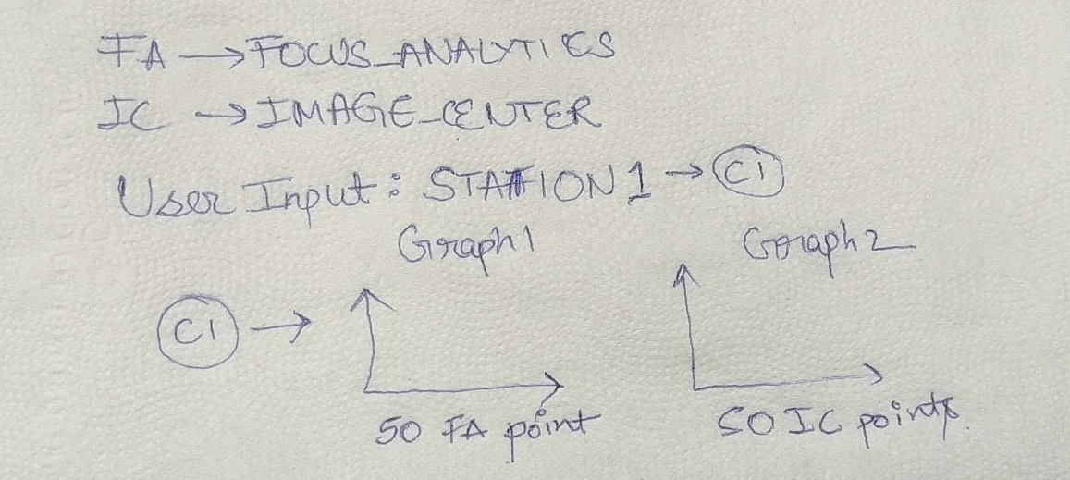
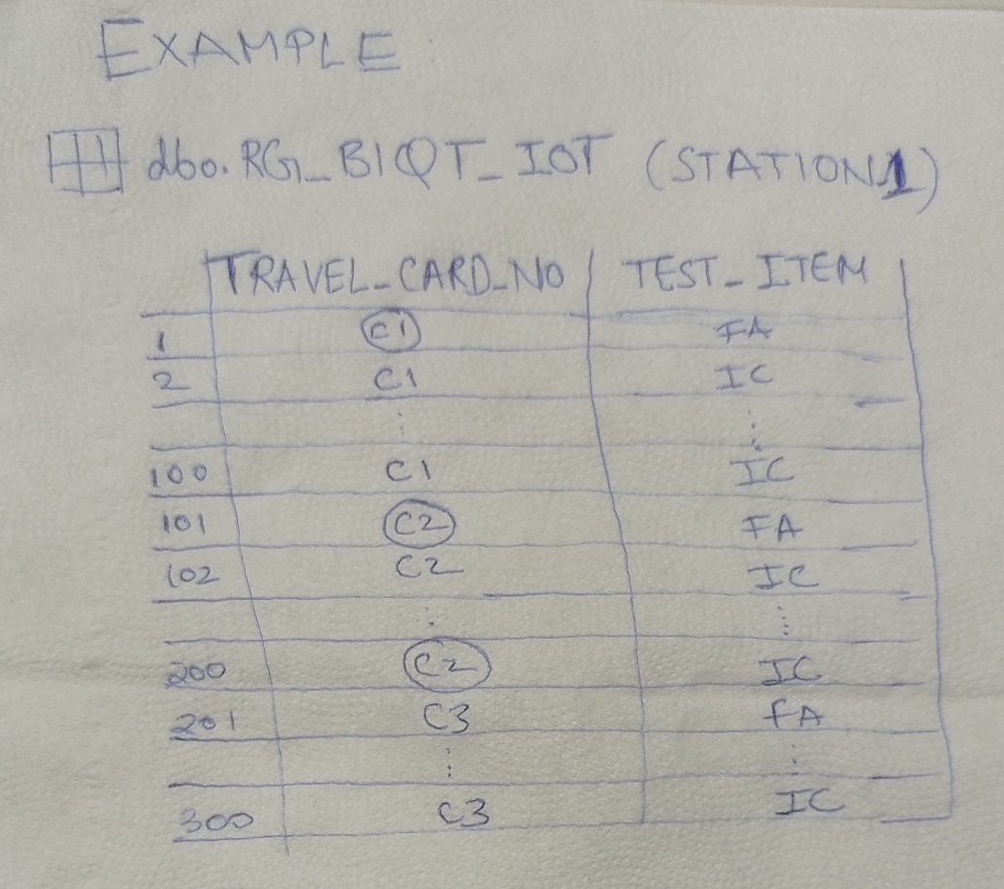
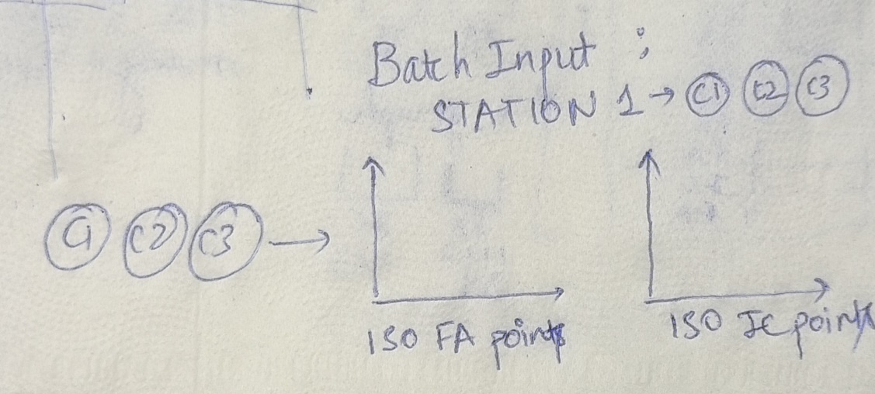
Objective: The codes yet need to be finally tested one last time so ive provided a handwritten graph output.
Demonstration for the graph plottings.
User input and batch input function demonstration.

Slide 14
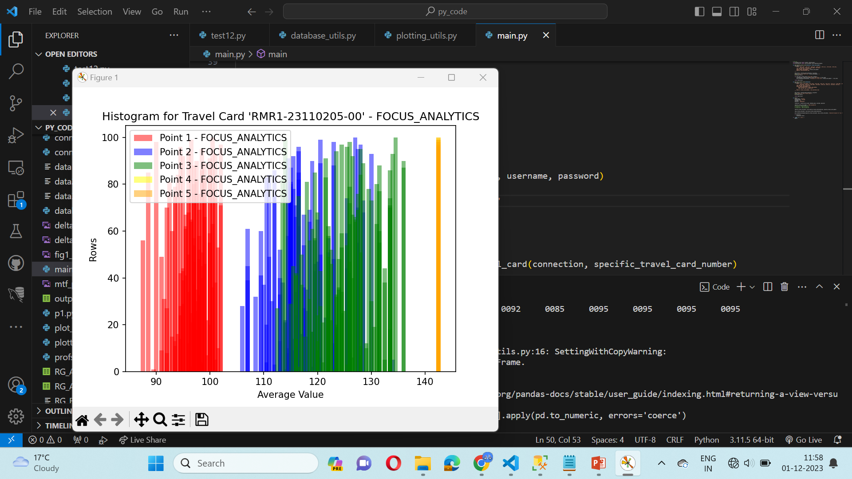
Objective: Previous tested histogram output.
For a particular TRAVEL_CARD, LIST_ITEM=“FOCUS_ANALYTICS”

Slide 15
Thank You!
REC Technology
Corporation
瑞柯科技
股份有限公司

